Slide 1
Object Oriented Programming Lecture-14
Inheritance: Inheritance in Java, Types, Constructor in Inheritance
Prof. Varsha Dange

Slide 2
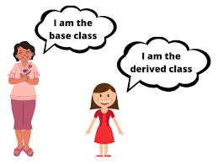
inheritance in Java
Inheritance is an important pillar of OOP.
The technique of creating a new class by using an existing class functionality is called inheritance in Java.
inheritance is a process by which a child class acquires all the properties and behaviors of the parent class.
The existing class is called parent class (a more general class) and the new class is called child class (a more specialized class).
The child class inherits data and behavior from the parent class.
Reusability: we can derive our new class from the existing class.
By doing this, we are reusing the fields and methods of the existing class.

Slide 3
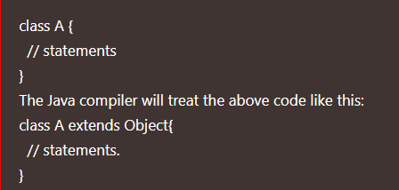
inheritance in Java
The keyword used for inheritance is extends.
Inheritance represents the IS-A relationship, also known as a parent-child relationship.
All the classes extends java.lang.Object by default.
So, every class acquires its properties from the object class.

Slide 4
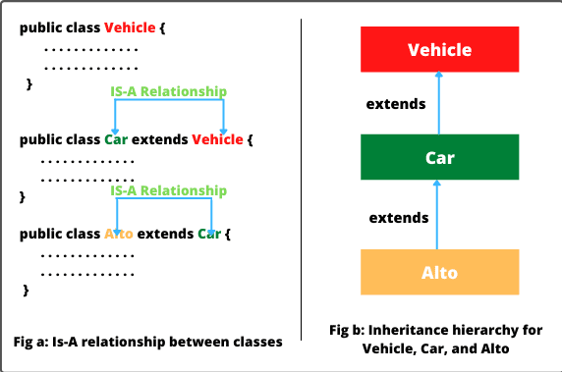
inheritance in Java-is a relationship

Slide 5
Important Terminology in Java Inheritance
Super class/Parent class/Base: The class from where a subclass inherits features is called super class
2. Subclass/Child class/Derived: A class that inherits all the members (fields, methods, and nested classes) from other class is called subclass.
A derived class extends its features by inheriting all the features of another class, called base class, and can also add its own features. The base class remains unchanged.

Slide 6
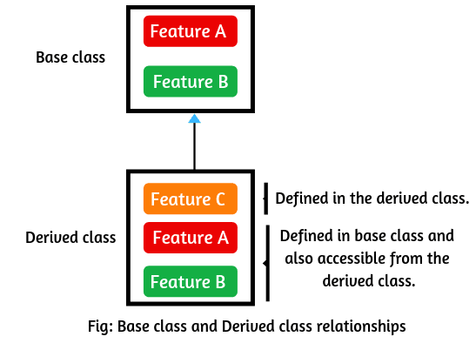
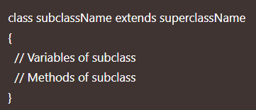
Creating Subclass in Java or Extending a class
A subclass can be created by using “extends” keyword.
Example

Slide 7
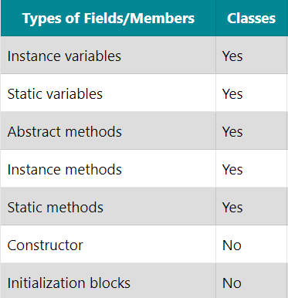
Inheritable Members of Classes

Slide 8
Why do we need/use Inheritance in Java
We can reuse the code from the base class.
Using inheritance, we can increase features of class or method by overriding.
Inheritance is used to use the existing features of class.
It is used to achieve runtime polymorphism i.e method overriding.
Using inheritance, we can organize the information in a hierarchical form.

Slide 9
How is Inheritance implemented/achieved in Java?
1. extends: extends is a keyword that is used for developing the inheritance between two classes and two interfaces.
Note that a class always extends another class. An interface always extends another interface and can extend more than one interface.
2. implements: implements keyword is used for developing the inheritance between a class and interface. (multiple inheritance)
A class always implements the interface.

Slide 10
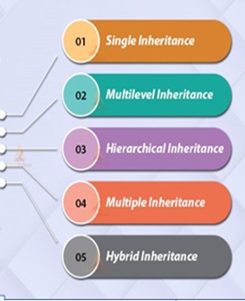
Types of Inheritance
Below are the different types of inheritance which are supported by Java.
1. Single Inheritance (using classes)
2. Multilevel Inheritance (using classes)
3. Hierarchical Inheritance (using classes)
4. Multiple Inheritance (using Interfaces)
5. Hybrid Inheritance (using Interfaces)

Slide 11
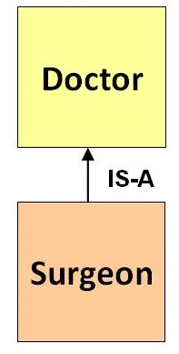
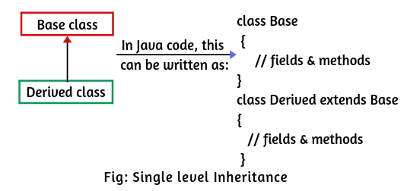
Types of Inheritance
1. Single Inheritance: In single inheritance, subclasses inherit the features of one super class.
Example

Slide 12
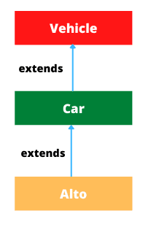
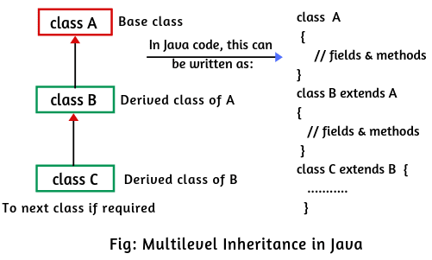
Types of Inheritance
2. Multilevel Inheritance: In Multilevel Inheritance, a derived class will be inheriting a base class and as well as the derived class also act as the base class to other class.
Example

Slide 13
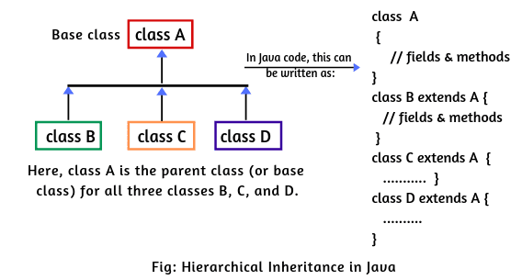
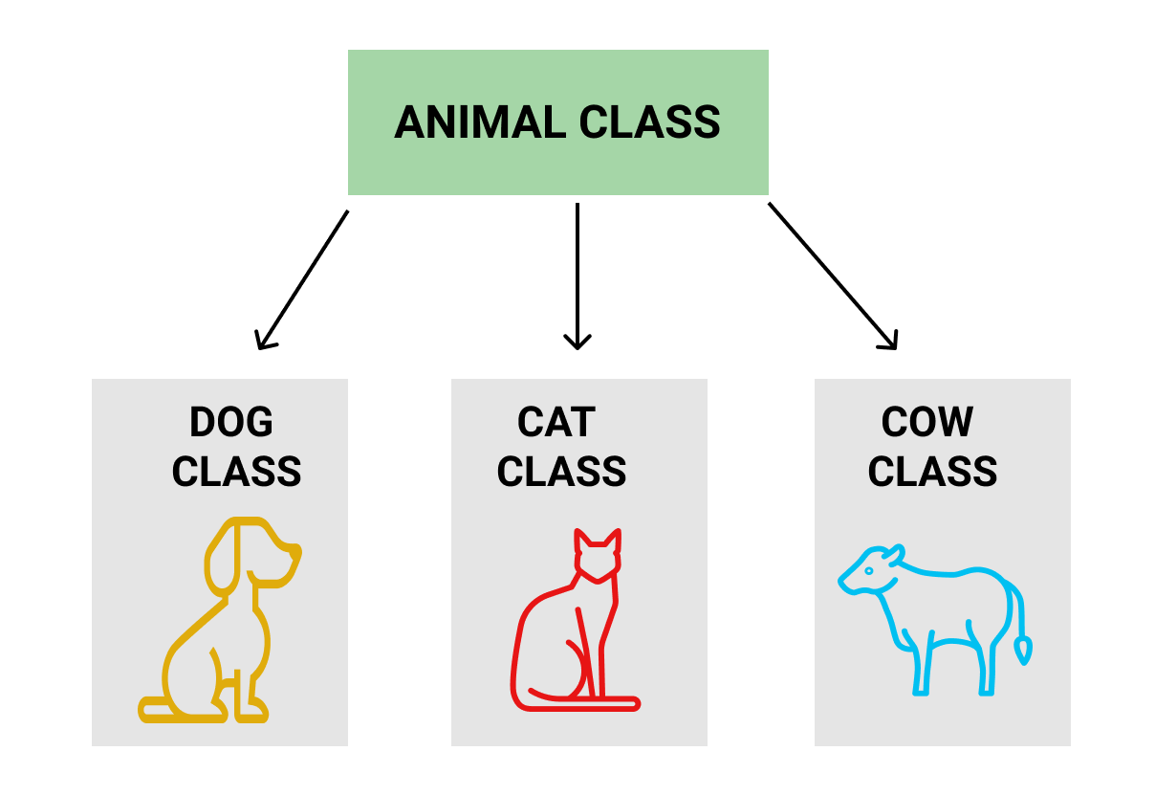
Types of Inheritance
3.Hierarchical Inheritance: In Hierarchical Inheritance, one class serves as a super class (base class) for more than one subclass.
Example

Slide 14
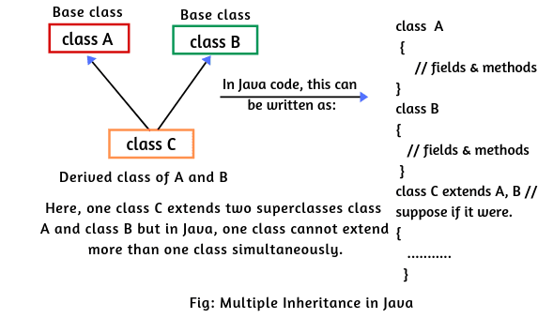
Types of Inheritance
4. multiple inheritance : Deriving subclasses from more than one superclass is known as multiple inheritance in java.
when a class extends multiple classes, it is known as multiple inheritance.
Java does not support multiple inheritance through class.

Slide 15
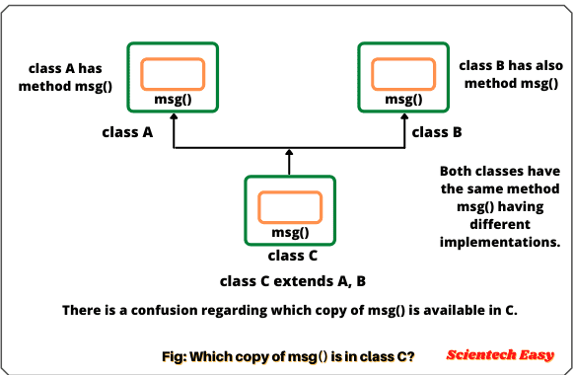
Types of Inheritance
it creates ambiguity, complexity, and confusion when a class inherits methods from two super classes with the same method signature.
The ambiguity created by the multiple inheritance is called diamond problem in java.
But, the functionality of multiple inheritance in Java can be achieved by using interfaces.
Example

Slide 16
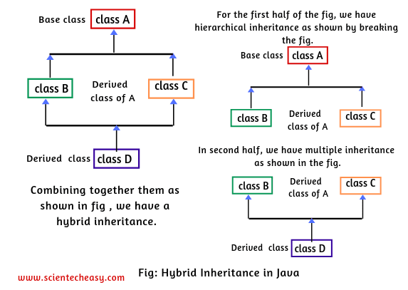
Types of Inheritance
A hybrid inheritance in Java is a combination of single and multiple inheritance.
It can be achieved in the same way as multiple inheritance using interfaces in Java.

Slide 17
Role of Constructor in Java Inheritance
The role of constructor in inheritance is that the constructor in the super class is responsible for building an object of super class and
the constructor of subclass builds an object of subclass.
When the constructor of a subclass is called during the object creation, by default, it calls the default constructor of super class. Example
But, if we want to call parameterized constructor of base class, then we can call it using super().
It must be the first statement in a constructor.
Example1

